Slide 1
Supplementary Material for the paper: Deep Fully-Connected Networks for Video Compressive Sensing
Michael Iliadis, Leonidas Spinoulas and Aggelos K. Katsaggelos

Slide 2
Reconstruction of full videos
We demonstrate reconstruction of full video sequences using the proposed method FC7-10M and the previous method GMM-4.
Note that GMM-4 was the only previous method allowing reconstruction of full video sequences due to the required reconstruction time.
We wanted to show full video reconstruction and opted to show only a few of the tested video sequences to reduce the file size.

Slide 3
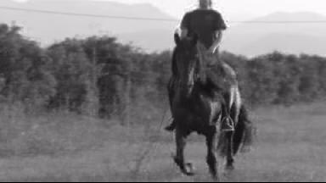

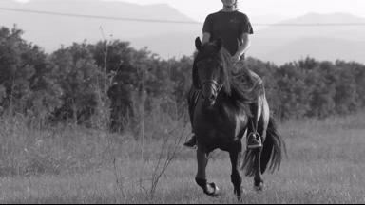
Horse video sequence
FC7-10M
GMM-4
Original

Slide 4
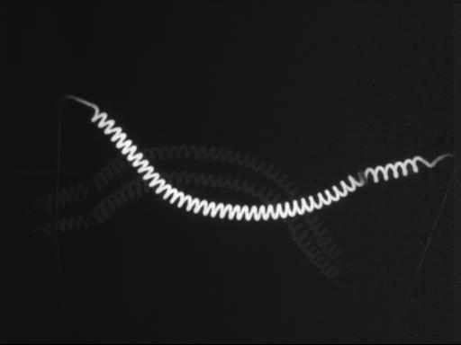


Filament video sequence
FC7-10M
GMM-4
Original

Slide 5
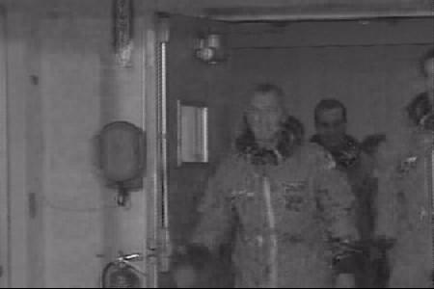
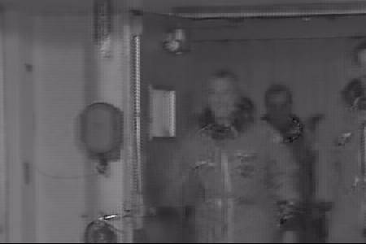
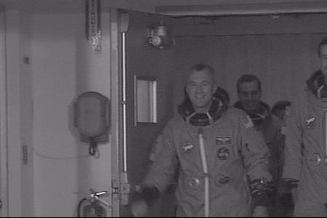
Crew video sequence
FC7-10M
GMM-4
Original

Slide 6
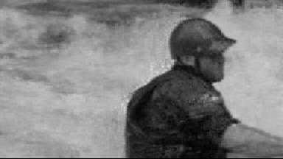


Kayak video sequence
FC7-10M
GMM-4
Original

Slide 7
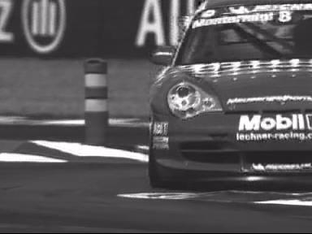

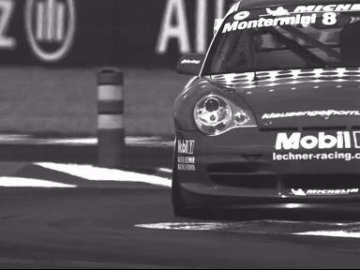
Porsche video sequence
FC7-10M
GMM-4
Original

